Slide 1
Data Visualization Challenge
December 10, 2020
Jesse Rowles

Slide 2
Overview
Daily Time Series with Events Highlighted
Pie Chart of Total Volume Used
Stacked Bar Chart for Hour of Day
Stacked Bar Chart for Day
Stacked Bar Chart of Proportion of Type by Day
Efficiency Improvements Based on Water-Limiting Behaviors
Compare Building To Nearby/Similar Buildings
Histogram Comparisons to Nearby Homes
Trend Projections

Slide 3
Notes
All event types are color-coded throughout (e.g., pink is always irrigation, green is always hose, etc.)
Irrigation mostly ignored
Data was following suggested volume of irrigation for size or property
Makes analysis difficult due to overpowering
Cost of water not considered, just volume
Rates of water usage different in other areas
Can change throughout time also

Slide 4
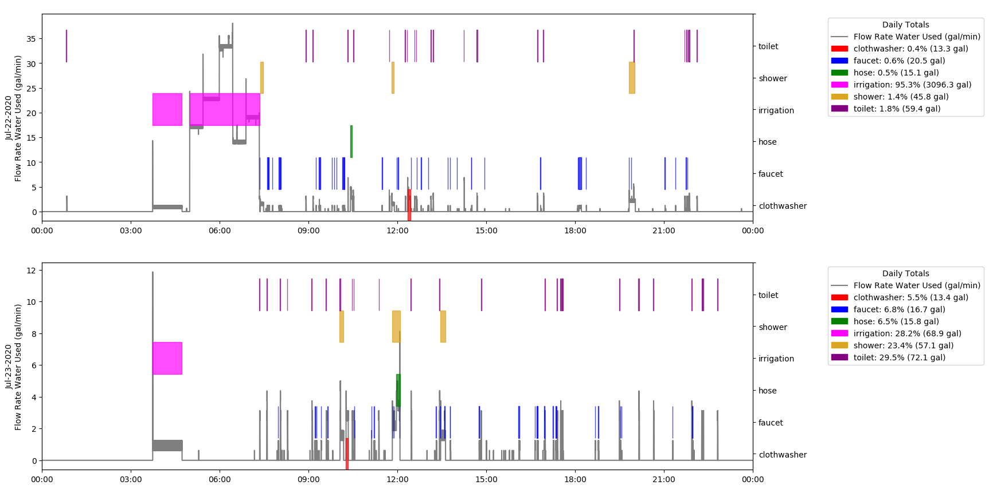
Daily Time Series with Events Highlighted
Colored polygons show when event occurs
Black line is time series of water used (in gallons)
Legend shows volume of water used for each type of event
Intended to show frequency and duration of events

Slide 5
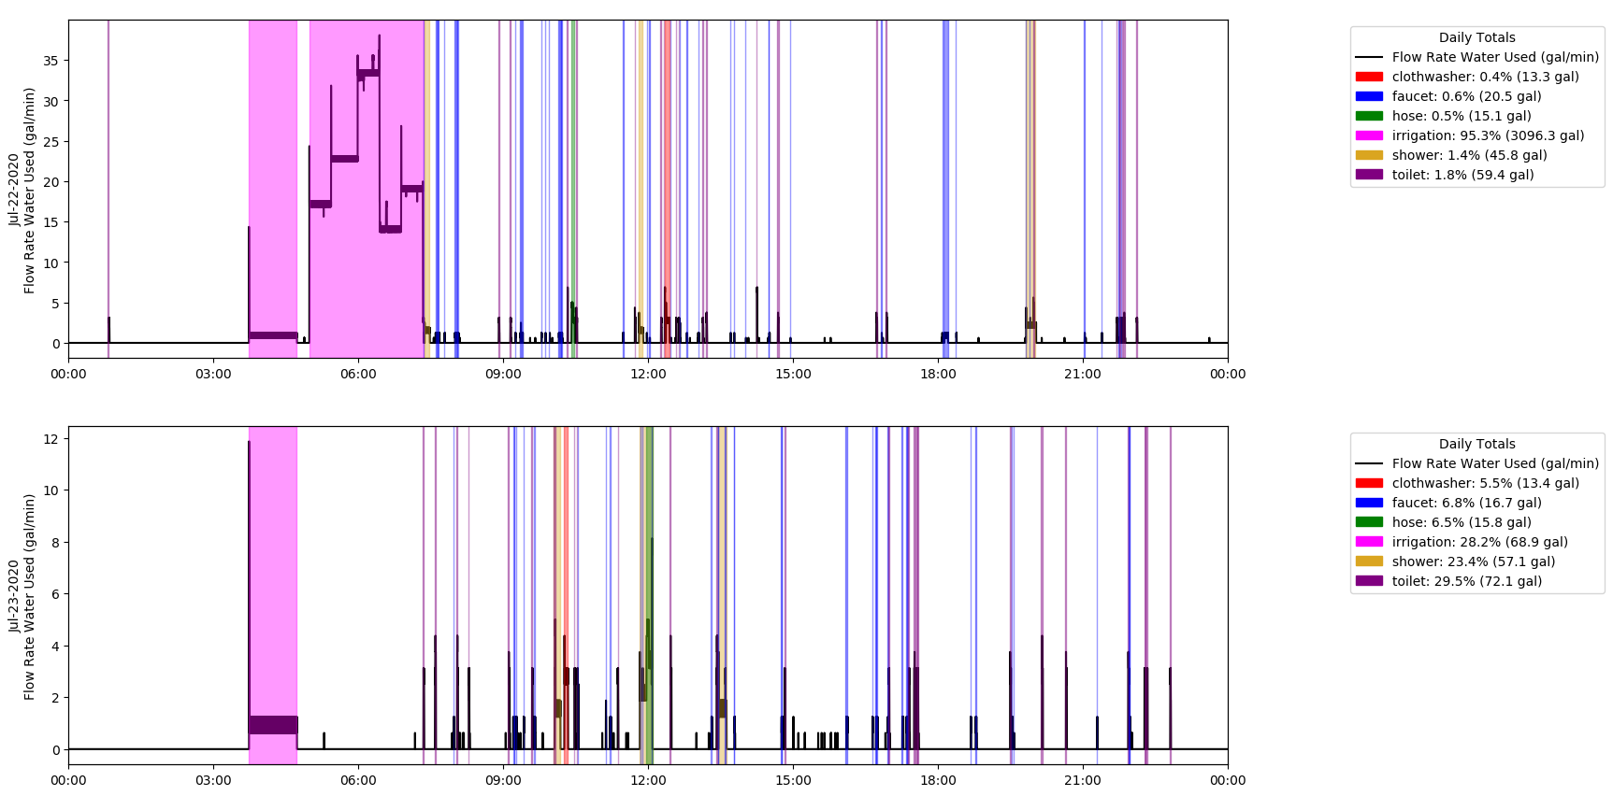
Daily Time Series with Events Highlighted Variant
Notes:
May be more visually appealing in some ways, but I find it difficult to read when there are multiple events occurring at the same time, especially when the events last such a short amount of time

Slide 6
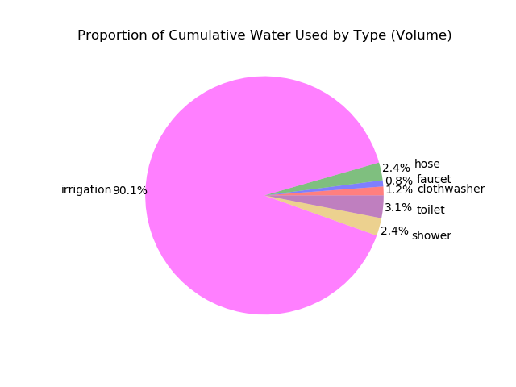
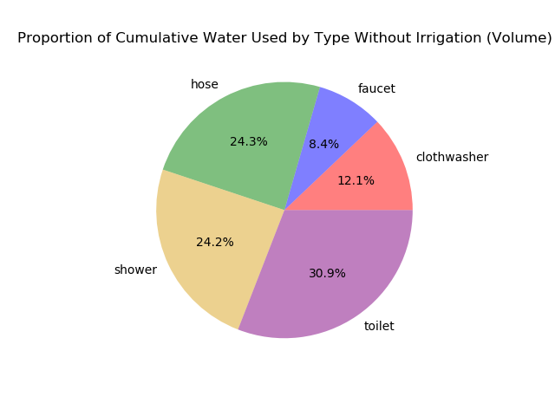
Pie Chart of Total Volume Used
Notes:
cumulative

Slide 7
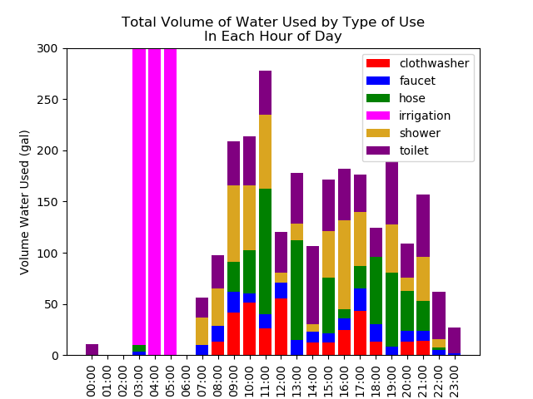
Stacked Bar Chart for Hour of Day
Shows sum of all water used for each event type in each hour of day over period of record
Intended to show times of most water use
Where water is going
When high-volume times are to limit water use
Draw attention to unexpected trends in time of day
Suggest when activities could be moved around
Notes:
Draw attention to unexpected trends in time of day (e.g., if nobody is home from 9-4 but water use is high – why?)
Move timing of activities (e.g., using hose outside period of day when evaporation is high like 11a-12p)

Slide 8
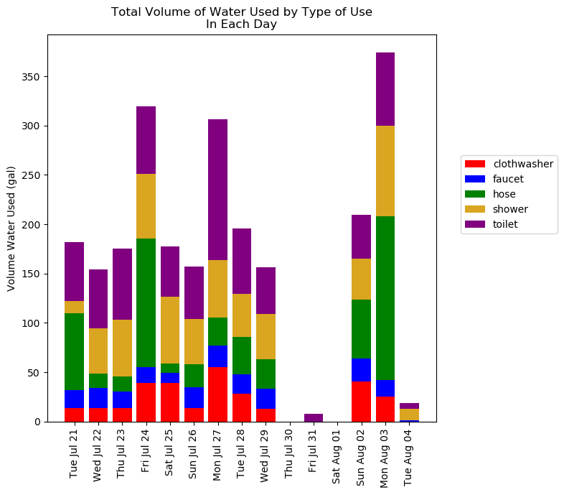
Stacked Bar Chart for Day
Stacked bar chart to indicate days of high-use and by how much
Useful in showing trends throughout year
Would also be useful as week or month of year instead of day to show trends throughout year
Notes:
Day of week added

Slide 9
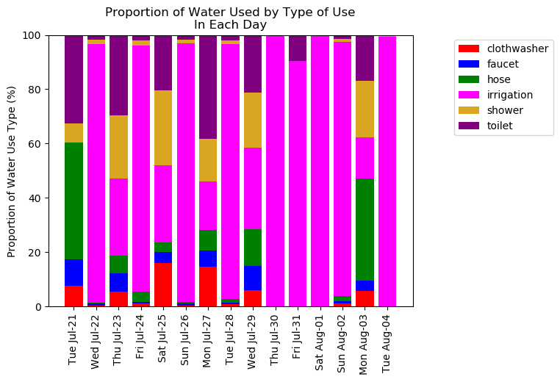
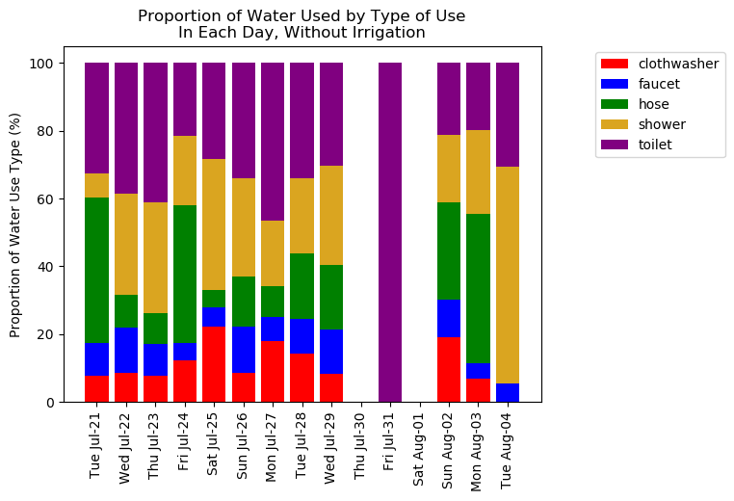
Stacked Bar Chart of Proportion of Type by Day
All Types Without Irrigation
Notes:
Day of Week

Slide 10
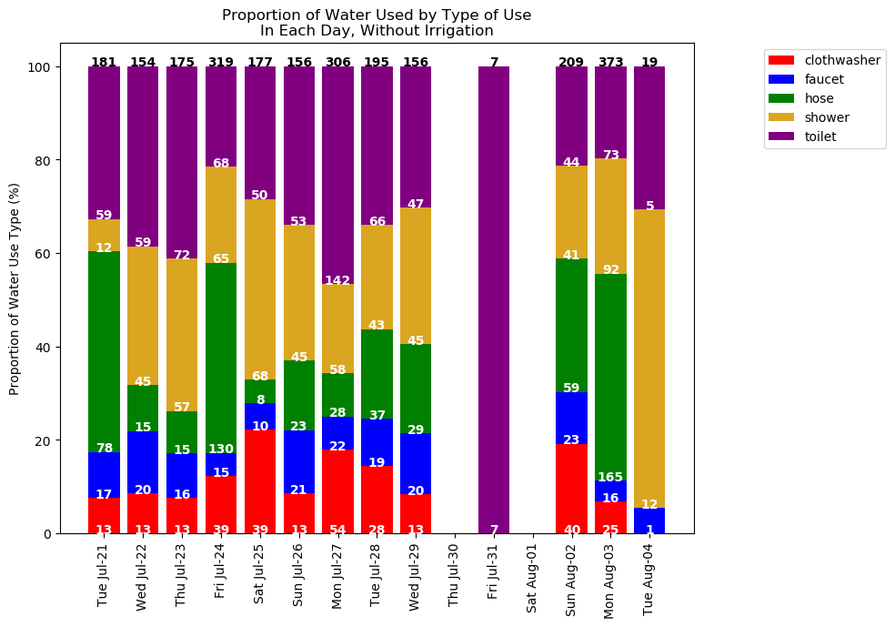
Stacked Bar Chart of Proportion of Type by Day - Variant
Add volumes of each type and total to indicate both proportion of total water used as well as volume
Helps to show days when little or a lot of water are used while showing breakdown (e.g., Jul 31)
Notes:
Numbers Could be misleading, so needs to be made clear that numbers are not percentages, but volumes (although could easily show %s instead)
May be difficult in days to view numbers with irrigation dominating

Slide 11
Efficiency Improvements Based on Water-Limiting Behaviors - Overview
Suggested behaviors to limit volume of water used (examples, not meant to be realistic or doable)
Limit shower durations to 10 minutes
Replace shower heads with low-flow heads at a maximum of 1.5 gpm (duration of showers unchanged)
Replaced toilets with low-flow/water-efficient toilets that use a maximum of 1.3 gal per flush
Replace faucet heads with more efficient water heads, reducing each faucet use to 75% original flow rate
All above improvements implemented
Notes:
Faucet 75% - Average flow rate of faucet events was 2.2 gpm
High-efficiency faucet heads can operate at a maximum of 1.6 gpm
1.6 gpm / 2.2 gpm = 75%

Slide 12
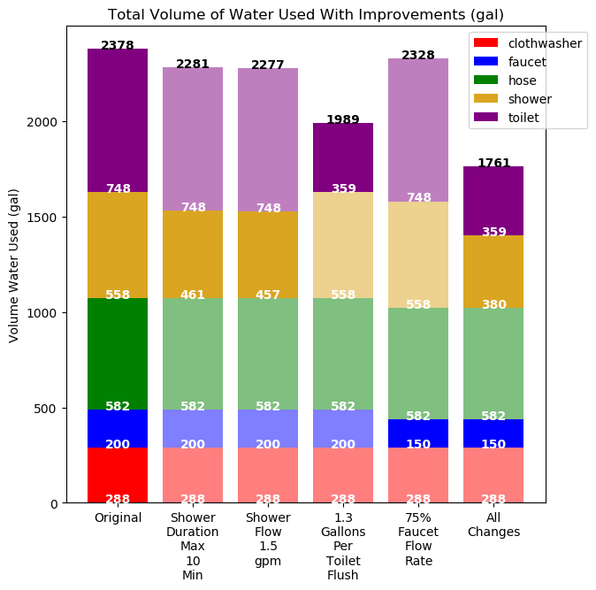
Efficiency Improvements Based on Water-Limiting Behaviors – Volume Plot
Total volumes of each type shown
Colors of bar section are bold if value changes from original
Used to determine money saved or highlight measures with largest impact
Notes:
Separate plot for irrigation

Slide 13
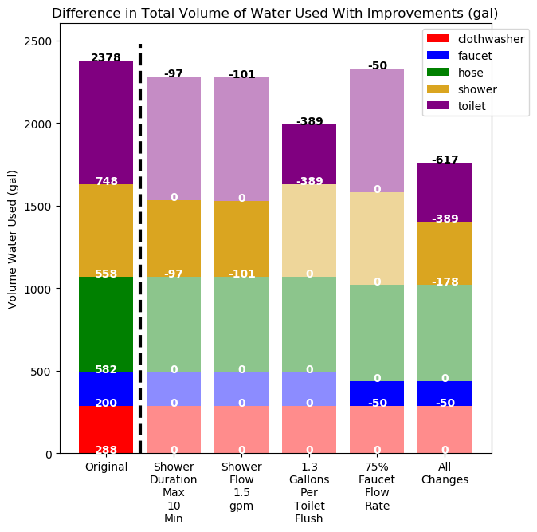
Efficiency Improvements Based on Water-Limiting Behaviors – Difference Plot
Other columns show change in volume from original for each type and total with improvement implemented
Something similar could be done for irrigation
Adjusting time of day to decrease evapotranspiration (if possible)
Could also be done as percent reduction of original or money saved
Notes:
Dim all ones that don’t changes

Slide 14
Compare Building To Nearby/Similar Buildings
Percentiles of water efficiency – how building of interest compares to others (e.g., “your home is in the 80th percentile of faucet usage in homes in a 50-miles radius”)
Show how building of interest compares to nearby buildings
Provoke interest in home/building owner to ask around and see what practices others are using
Nearby home data created by multiplying given data by random decimal for visualization purposes

Slide 15
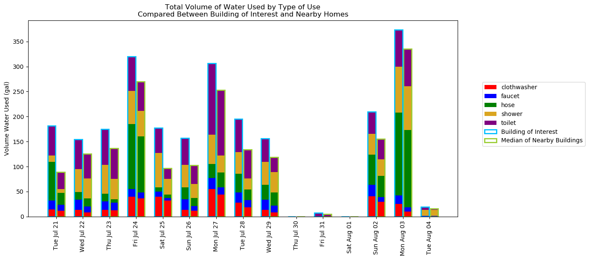
Compare Building To Nearby/Similar Buildings Example Overview

Slide 16
Compare Building To Nearby/Similar Buildings Potential Enhancements
Per person
Per acre
Different time scales
Classifying nearby buildings similarly to one of interest
Notes:
Classifying buildings - (e.g., compare home to nearby homes, industrial to nearby industrial, etc.)

Slide 17
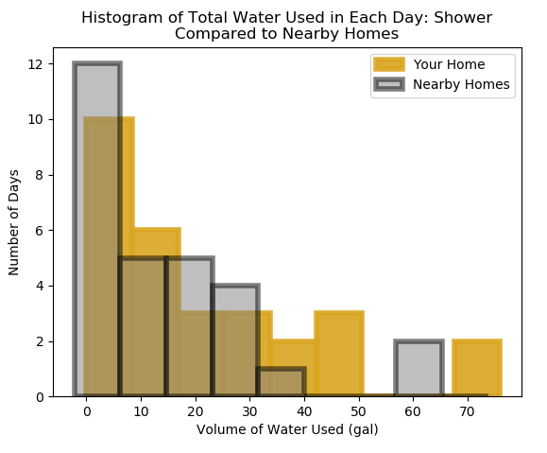
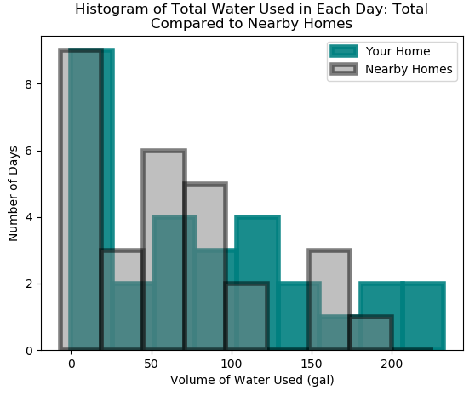
Histogram Comparisons to Nearby Homes
Histograms of 12-hour totals of volume of water used in home of interest and nearby homes for each type and total
Better for more time
Another method of comparison to indicate days of higher water use than surrounding homes
Notes:
Individual plots for each type could indicate problem use areas (e.g., if shower histogram has many bars higher than surrounding areas, but all others don’t)
Could show if one volume range has many more than others and cause homeowner to consider why
Histogram may be advanced concept for average homeowner

Slide 18
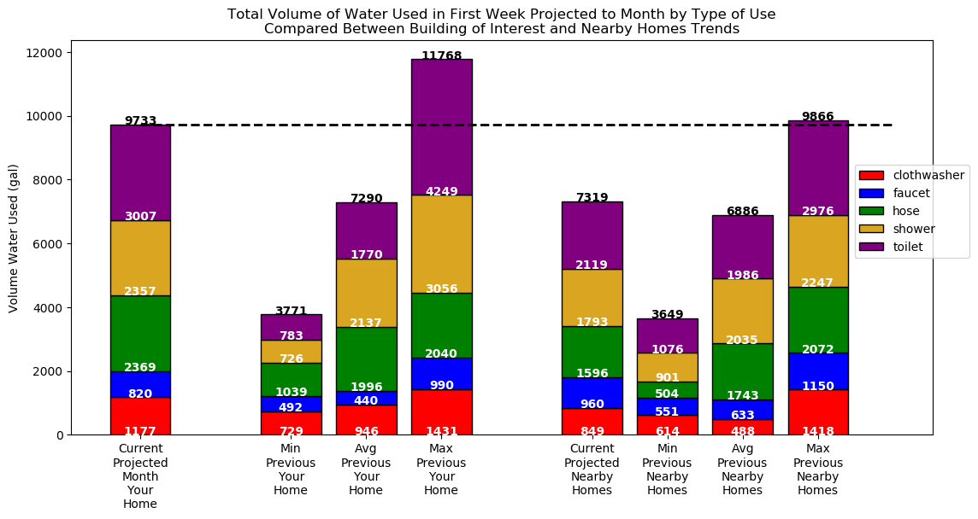
Trend Projections
Projecting water use to a longer time scale
Compare
To past at building of interest
To other nearby buildings
Alert homeowners to use trends to keep end use down in future
Notes:
(e.g., projecting first week of month to monthly scale)

